Slide 1
Affordable Care Act in Illinois: Past, Present, and Future
Alicia Siani
Policy Analyst
EverThrive Illinois
asiani@everthriveil.org
Illinois League for Nursing
October 16, 2015

Slide 2
^{VISION}
EverThrive Illinois envisions an Illinois that works towards equity and social justice, fosters the development of healthy families, and provides fair access to quality health care – the basic rights of all human beings.
^{PRIORITY AREAS}
Immunizations across the lifespan
Health care and health education in schools
Infant and maternal morbidity and mortality reduction
The elimination of health disparities among all populations
Leadership development in maternal and child health field
^{Reproductive health}
Healthy lifestyles, nutrition, and cooking education
http://www.everthriveil.org

Slide 3
Objectives
Affordable Care Act 101
The Illinois experience
Key takeaways for health care providers
Q&A

Slide 4
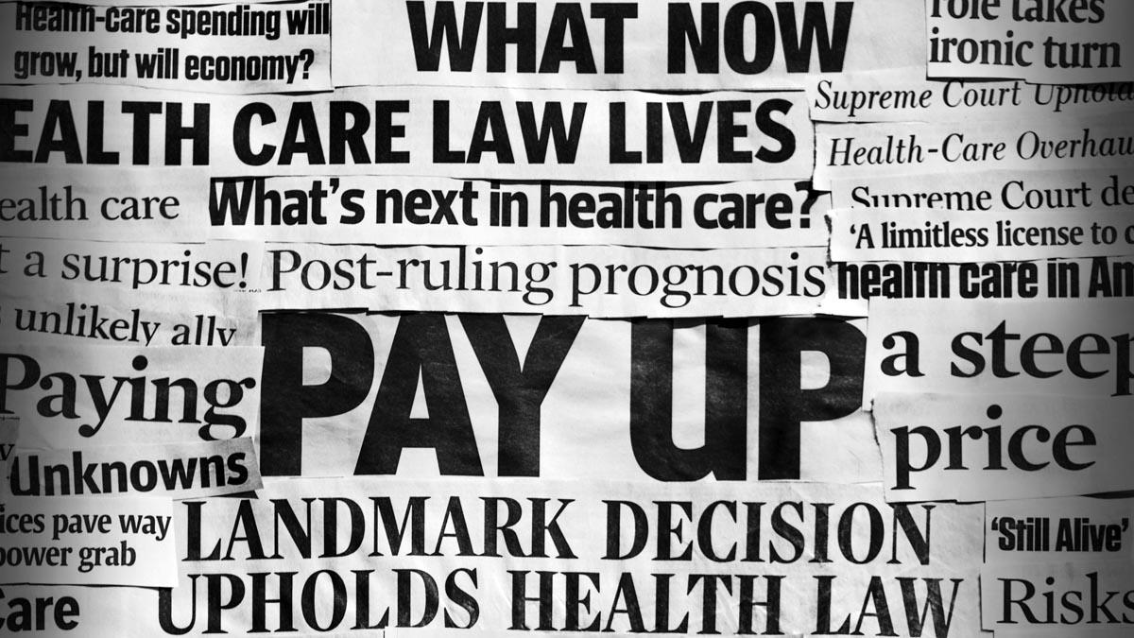
Affordable Care Act 101

Slide 5
Health care in America, 2010
Access: Nearly 50 million Americans lacked health insurance
Cost: USA spent $2.6 trillion on healthcare annually
Quality: USA ranked 50th in life expectancy
Notes:
Among the seven nations studied—Australia, Canada, Germany, the Netherlands, New Zealand, the United Kingdom, and the United States—the U.S. ranks last overall, as it did in the 2007, 2006, and 2004 “ Commonwealth Fund

Slide 6
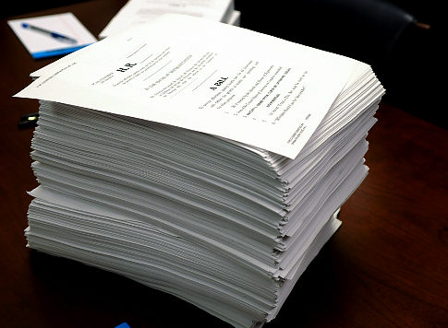
ACA at a Glance
.
Expand and Strengthen Health Insurance Coverage
ACA SIGNED INTO LAW MARCH 23, 2010
Improve Access to Primary and Preventive Care
Reward Quality, Not Quantity
Notes:
Animation ! For

Slide 7
Expand and Strengthen Health Insurance Coverage
Consumer Protections
Must spend 80-85% of premium dollars on Medical Coverage
Extended dependent coverage available up to age 26
Can’t discrimination against individuals with pre-existing conditions

Slide 8
Essential Health Benefits
Expand and Strengthen Health Insurance Coverage

Slide 9
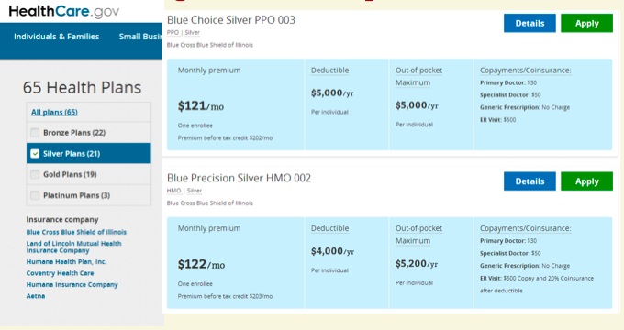
Health Insurance Marketplace
Expand and Strengthen Health Insurance Coverage
Marketplace? =
Online shopping tool:
Shop for health insurance
Compare benefits and prices
Enroll in a plan
Access financial assistance
Who can use a marketplace?
US Citizens
Lawfully present residents
Small businesses (fewer than 50 employees)

Slide 10
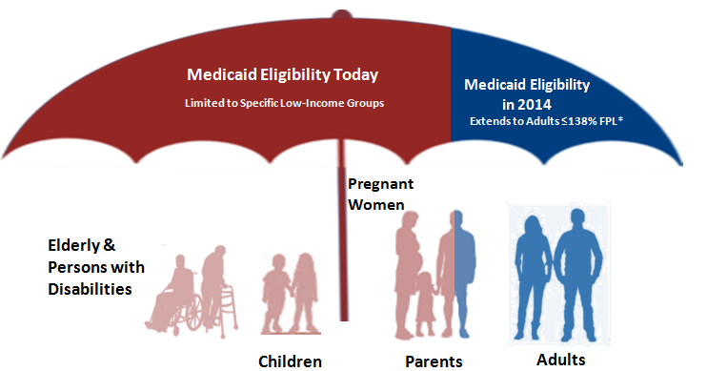
Medicaid Expansion
Expand and Strengthen Health Insurance Coverage
-US Citizens or lawfully permanent residents of 5 years or more and
-Income below 138% FPL (Family of 4= ~$33,000 annual income

Slide 11
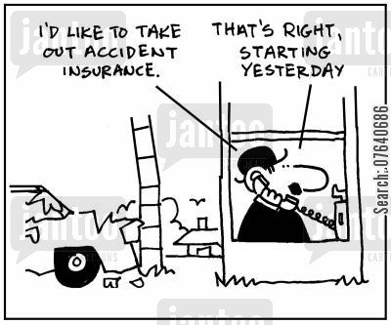
Shared Responsibility Provision
Expand and Strengthen Health Insurance Coverage
Individual
Employer
Starting January, 2014, individuals must maintain minimal essential coverage or pay penalty
Year 2: Penalty = $325 or 2% of taxable income, whichever is greater
Beginning in 2016, Employers must provide coverage for FTE’s (full time employees) working 30+ hours if they employ 50 or more FTE’s.
Notes:
Estimated 3-6 million

Slide 12
ACA at a Glance
.
Expand and Strengthen Health Insurance Coverage
ACA SIGNED INTO LAW MARCH 23, 2010
Improve Access to Primary and Preventive Care
Reward Quality, Not Quantity
Notes:
Animation ! For

Slide 13
Improve Access to Primary and Preventive Care
Preventive Services w/ no cost sharing
Notes:
NOTE: Animation
Preventive benefits slides
These groups make recommendations on evidence-based preventive services
-US PREventive Services Task Force
-CDC Advisory Committee on Immunizatins
-Health Resources and Services Administraiton’s Bright Future
-Institutes of Medicine

Slide 14
Improve Access to Primary and Preventive Care
Prevention and Public Health Fund
ACA created first dedicated fund for prevention
Investments for local health departments and organizations that deal with smoking, obesity, diabetes, heart disease and stroke, immunization, suicide prevention, and early cancer detection
Notes:
More than half of Americans suffer from chronic diseases, such as type 2 diabetes and heart disease. Two thirds of Americans are currently obese or overweight and nearly 20 percent of Americans smoke. Obesity costs the country $147 billion and tobacco use $96 billion in direct healthcare costs each year.
I mentioned earlier that the US spends about 2.6 trillion a year on health care, about 75% of that goes towards treating chronic, often avodiable diseases, such as type 2 diabetes and lung cancer.
The Affordable Care Act (ACA), for the first time in the nation’s history, created a dedicated fund for prevention. (supposed to be $14.5 billion over 10 years)
local health departments and organizations that deal with smoking, obesity, diabetes, heart disease and stroke, immunization, suicide prevention, early cancer detection and other issues.

Slide 15
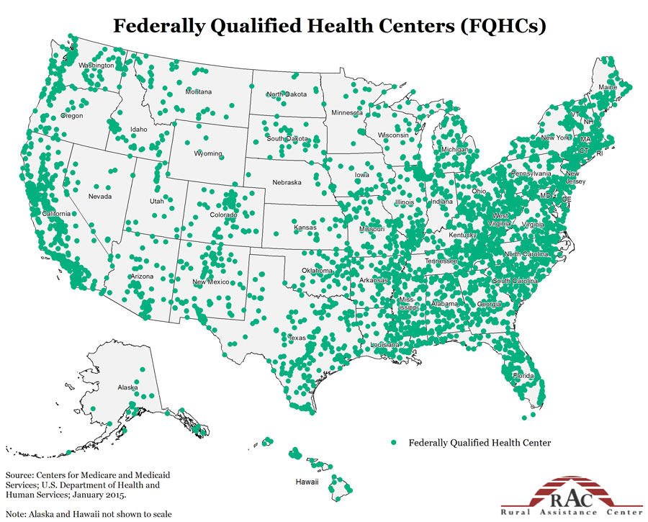
Improve Access to Primary and Preventive Care
Expand PCMH, FQHC’s
Six features of PCMH under ACA:
A whole person orientation
Coordinated and integrated care
Safe & high quality care through evidence-informed medicine
Appropriate use of health information technology
Continuous quality improvements
Payment that recognizes added value from additional components of patient-centered care
o Create new health center sites in medically underserved areas.
o Expand preventive and primary health care services at existing health center sites.
• Support major construction and renovation projects at community health centers nationwide.
Notes:
Around the world, evidence suggests that strong primary care systems lead to better health outcomes at lower cost
The affordable care act includes many provisions designed to increase access to primary care, in both system delivery and workforce supports. We’re first going to talk about system delivery.
The ACA promotes the Patient Centered Medical Home model.
Can anyone describe what a patient medical home for me?
Generally speaking, PCMH are characterized by:
Prompt access to medical care
Emphasis on relationship with primary care provider
Adoption of heallth information technology to improve coordination of care
Specifically, the Affordable Care Act promotes PCMH model by
1) Increasing Medicaid reimbursements for states that create health homes
2) Allowing the Secretary of HHS to expand PCMH and other coordinate care models without acts of Congress
In addition to exploring new models of care, like the PCMH, in order to increase access to primary care, the ACA also attempts to expand access to primary care by bolstering Community Health Centers.
-Traditionally Community Health centers, also called FQHC’s FQHCs are “safety net” providers .The main purpose of the FQHC Program is to enhance the provision of primary care services in underserved urban and rural communities.
-The affordable Care act increases support for FQHC’s by adding new sites, provides funding for FQHC’s to expand additional services, such as behavioral health servcies, and support construction

Slide 16
Electronic Health Records (EHR)
An electronic health record (EHR)—sometimes called an electronic medical record (EMR)—allows healthcare providers to record patient information electronically instead of using paper records.
The Affordable Care Act includes funding to expand the use of EHR’s
Example: Near North Health Service Corporation (Chicago) received $625,000 in 2012 to promote enhanced sharing of information and expertise with EHR’s

Slide 17
Improve Access to Primary and Preventive Care
ACA Workforce Supports
Authorizes increased funding for:
Title VIII nurse workforce/education and loan repayment programs
Creates Public Health Workforce Loan repayment program
Increased reimbursement for Medicaid and Medicare primary care providers
Notes:
In addition to promoting brick and mortar opportunities for consumers to seek preventive and primary care by promoting PCHMH and expanding Community Health Center Access and services, the ACA also has several provisions to develop a workforce to meet the needs of an increasingly insured population.
I printed out a fact sheet with this information because I figured this could be of particular interest to you, but quickly I wanted to highlight that:
Investments in The National Health Service Corps –which provides scholarships and loan repayment to health care providers who commit to providing care in the communities who need them most- contributed to a doubling of enrollment in the program.
Investing in more primary care residencies
2013 and 2014, Medicaid is required to reimburse primary care providers (PCPs) at parity with Medicare rates—a “bump” that is funded 100 percent by the federal government.

Slide 18
ACA at a Glance
.
Expand and Strengthen Health Insurance Coverage
ACA SIGNED INTO LAW MARCH 23, 2010
Improve Access to Primary and Preventive Care
Reward Quality, Not Quantity
Notes:
Animation ! For

Slide 19
Reward Quality, Not Quantity
Alternative Payment Models
Hospital Readmissions Reduction Program
Creation of Accountable Care Organizations (ACO’s)
Bundled Payments
“In 2011, Medicare made almost no payments to providers through alternative payment models, but today such payments represent approximately 20 percent of Medicare payments. ”
– HHS Fact Sheet 1/26/15
Fee for Service
Notes:
The United States spends more than any other industrialized country on health care, but doesn’t have the outcomes to reflect that investment. The Affordable Care Act made significant steps in attempting to move our traditional fee-for-service health payment models to incentiving higher quality and saving by providing funding for health providers and health systems to engage in alternative payment models. Some are optional and some are mandatory. incentivize health care providers to be more cost efficient.
- For example, the Affordable Care Act established the Hospital Readmissions Reduction Program, which requires CMS to reduce payments to IPPS hospitals with excess readmissions.
This year, hospitals can lose as much as 3 percent of their Medicare payments under the program, which is overseen by the federal Centers for Medicare & Medicaid Services (CMS). To determine each hospital’s penalty, CMS looked at the readmissions rates of patients who initially went into the hospital for one of five conditions but returned within 30 days of discharge
Bundled payment programs refer to the concept of grouping together the multiple services associated with a certain health “episode”, condition or procedure – encompassing everything from an early breast cancer diagnosis, to a joint replacement or pacemaker implant. In the current fee for service system, each service associated with a condition is charged separately. In a bundled payment program, all services relating to a certain episode are grouped together from the initial tests and consultations, to the surgeries, drugs and post-op rehabilitation. Some have referred to it as the difference between paying for a meal a la carte versus a prix fixe menu. Shaping the World of Healthcare Law
Home > Affordable Care Act (ACA) > Bundled Payments under the Affordable Care Act Continue to Gain Influence
Bundled Payments under the Affordable Care Act Continue to Gain Influence
By Eric Klein, Lynsey Mitchel and Lauren Lee Tarantello on August 8, 2014Posted in Affordable Care Act (ACA)
The Center for Medicare and Medicaid Services (CMS) recently announced that it will add roughly 4,100 providers to the 2,400 existing providers testing the possible use of Medicare bundled payment contracts. Providers must apply to be candidates, and this group of now roughly 6,500 providers, including both hospitals and medical groups, will participate in analyzing Medicare spending data to assess possible bundled payment options. This all comes as part of the Bundled Payments for Care Improvement initiative (BPCI), just one of the Affordable Care Act’s many attempts to incentivize health care providers to be more cost efficient.
Bundled payment programs refer to the concept of grouping together the multiple services associated with a certain health “episode”, condition or procedure – encompassing everything from an early breast cancer diagnosis, to a joint replacement or pacemaker implant. In the current fee for service system, each service associated with a condition is charged separately. In a bundled payment program, all services relating to a certain episode are grouped together from the initial tests and consultations, to the surgeries, drugs and post-op rehabilitation. Some have referred to it as the difference between paying for a meal a la carte versus a prix fixe menu.
Proponents of the bundled payment initiative are hopeful that this new approach to health care can lead not only to increased accountability for health care spending (and therefore greater cost-consciousness from providers), but also more transparency for health care consumers, whether employers, health insurers, or the patients themselves. Early market studies are showing a hearty enthusiasm from consumers, who are eager to better understand the costs of their care.
In the BPCI initiative, providers are generally required to reduce Medicare costs by 2%-3.5% in order to earn the program’s rewards. hearart failure and heart attacks, pneumonia and worn-down joints.
Accountable Care Organizations:
-An ACO is a network of doctors and hospitals that shares financial and medical responsibility for providing coordinated care to patients in hopes of limiting unnecessary spending. At the heart of each patient’s care is a primary care physician.
In Obamacare, each ACO has to manage the health care needs of a minimum of 5,000 Medicare beneficiaries for at least three years. ACOs don’t do away with fee for service, but they create an incentive to be more efficient by offering bonuses when providers keep costs down. Doctors and hospitals have to meet specific quality benchmarks, focusing on prevention and carefully managing patients with chronic diseases. In other words, providers get paid more for keeping their patients healthy and out of the hospital.
-IN order to be eligible for bonuses, ACO’s have to meet specific quality metrics and achieve cost savings. 22 percent of those ACOs, qualified for shared savings payments by successfully reducing total spending.

Slide 20
The Illinois Experience

Slide 21
Creation of ABE
https://abe.illinois.gov/abe/access/
Notes:
Meet ABE. If GetCoveredIllinois points you to apply through ABE, you will see a hyperlink on the GCI page. When you click on that link you will be taken to the ABE web page.

Slide 22
Enrollment numbers
Medicaid Enrollment:
609,086 as of September 2015;
→206, 248 in Chicago
Marketplace Enrollment:
297,406 Illinoisans enrolled in Marketplace plans
→ 231,000 (about 80%) are receiving tax credits to help pay for this coverage

Slide 23
Consumer Protections
Must spend 80-85% of premium dollars on Medical Coverage
2012: 300,000 Illinois policyholders $61.8 million
Extended dependent coverage available up to age 26
2013:120,000 Illinois Young adults enrolled in parents’ plan
Can’t discrimination on pre-existing conditions
Insurance companies in Illinois could engage in gender rating, and charge more for coverage based on adverse health status
Sources: Crain’s Chicago Illinois health insurers to pay back millions in premiums
U.S. House Committee on Energy and Commerce, Democratic Staff

Slide 24
Prevention and Public Health Fund
As of July 2014, Illinois has received $56M from the Prevention and Public Health fund to support various investments in public health, include including:
Screening for Hepatitis C
Chicago Public Schools on anti-tobacco programs
Physical fitness programs
Immunizations programs
Sources: Chicago Tribune, “How Illinois Has Spent $56M From Health Law’s Prevention Fund” July 7, 2014

Slide 25
Medicare Care Coordination
A sampling of ACO’s in Illinois:
Kane County Independent Physician Association
Alexian Brothers Health Systems
North Shore University Health System
Presence Health
Northwest Community Healthcare
Illinois Health Partners
Independent Physician’s ACO of Chicago
Advocate Health Care
Notes:
@least 16 ACO’s – Blue cross blue sheld getting gin the game.

Slide 26
For Providers to Keep in Mind

Slide 27
Undocumented Not Covered

Slide 28
Continued Health System Transformation
Managed care plans will continue to come and go in Illinois
Health care networks will continue to shrink and grow- this will affect which providers are considered “in-network”- and which are not.
The federal government, state. and health plans will increasingly use quality measures to reward providers.
Sources: Kaiser Family Foundation (http://www.kff.org) analysis. Original data and detailed source information are available at http://kff.org/JAMA_05-14-2014.
Notes:
A 2006 study by the U.S. Department of Education found that 36 percent of adults have only basic or below-basic skills for dealing with health material.
Resources:
-Get Covered Illinois
-health care.gov

Slide 29
Health Literacy and Patient awareness
Health literacy is the degree to which an individual can obtain, understand, and act on information to meaningfully interact with the health care system and make decisions about their health.
4 in 10 women are unaware of preventive services
Clinicians are the most trusted source of information on the ACA
Sources: Kaiser Family Foundation (http://www.kff.org) analysis. Original data and detailed source information are available at http://kff.org/JAMA_05-14-2014.
Notes:
A 2006 study by the U.S. Department of Education found that 36 percent of adults have only basic or below-basic skills for dealing with health material.
Resources:
-Get Covered Illinois
-health care.gov

Slide 30
Pathways to Coverage
:www.GetCoveredIllinois.gov
866-311-1119
Marketplace
Enroll November 1- January 31
Medicaid
Enroll: All year round

Slide 31
Additional Resources
Kaiser Family Foundation
http://healthreform.kff.org/
National Health Service Corps
http://nhsc.hrsa.gov/
www.GetCoveredIllinois.gov
866-311-1119
Health Literacy Resources
http://www.hrsa.gov/publichealth/healthliteracy/
Notes:
For use as full body content slide.

Slide 32
Questions?
Alicia Siani
Policy Analyst, EverThrive Illinois
asiani@everthriveil.org
Email: Phone: 312-763-2389 x202
Visit our website at www.everthriveil.org
Find us on Twitter @EverThriveIL
Like us on Facebook at http://bit.ly/like_EverThriveIL
Notes:
For use as the last slide of presentations. Feel free to add in additional presenters contact information under our staff contact information.

